Slide 1
Neural Networks vs Deep Learning
Neural networks—and more specifically, artificial neural networks (ANNs)—mimic the human brain through a set of algorithms. At a basic level, a neural network is comprised of four main components: inputs, weights, a bias or threshold, and an output.
The “Deep” in Deep Learning is referring to the depth of layers in a neural network. A neural network that consists of more than three layers—which would be inclusive of the inputs and the output—can be considered a deep learning algorithm.
Deep Learning is a subset of Machine Learning composed of algorithms that permit software to train itself to perform tasks, like speech and image recognition, by exposing multi-layered neural networks to vast amounts of data

Slide 2
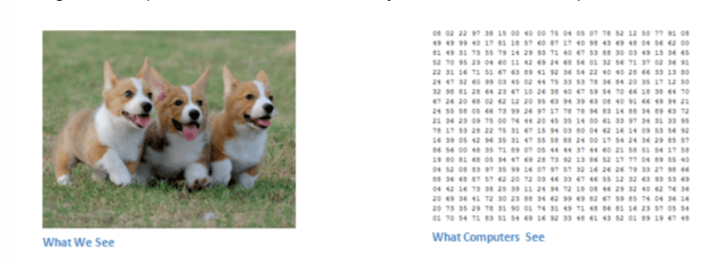
Introduction..
Have you ever thought how facial recognition works on social media, or how object detection helps in building self-driving cars, or how disease detection is done using visual imagery in healthcare? It’s all possible thanks to convolutional neural networks (CNN).
Computers ‘see’ in a different way than we do. Their world consists of only numbers. Every image can be represented as 2-dimensional arrays of numbers, known as pixels.
Notes:
Yann LeCun, director of Facebook’s AI Research Group, is the pioneer of convolutional neural networks. He built the first convolutional neural network called LeNet in 1988. LeNet was used for character recognition tasks like reading zip codes and digits.
Each of these numbers is given a value from 0 to 255 which describes the pixel intensity at that point

Slide 3
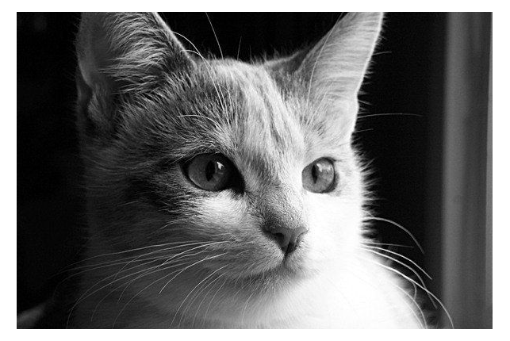
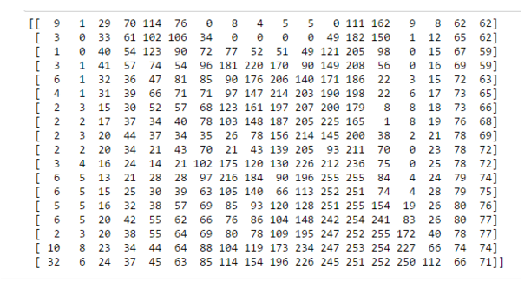
How do Computers see an image?
Computers see a Matrix of numbers (between 0 to 255). Broadly, we can classify images as grayscale images or color images.
The cat image is a grayscale image — that means each pixel represents the brightness of a pixel, which is the smallest controllable element of a picture represented on the screen.
This is how Computers see in case of cat image as below:
Computers see an image as a 2D matrix. Each element in the matrix represents the intensity of brightness in that pixel. Here, 0 represents black and 255 represents white color, and any value between these two is just a shade of gray.

Slide 4
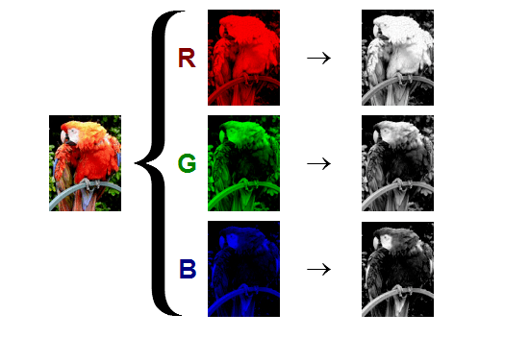
Cont..
In grayscale images, each pixel represents the intensity of only one shade — how bright or dark the pixel is. In other words, it has only one channel. On the other hand, in color images we have 3 channels: R, G and B (red, green, blue). Standard digital camera have 3 (RGB) channels. Standard digital camera have 3 (RGB) channels.
In this case, we have a 3D matrix. We have one 2D matrix for each channel, and we'll have three matrices for Red, Green and Blue channels stacked onto each other making the matrix 3D.
For example: Shape of a matrix representing a 700px by 700px color image will be (700, 700, 3). Each pixel in this color image has three numbers (ranging from 0 to 255) associated with it. These numbers represent intensity of red, green and blue color in that particular pixel.

Slide 5
Convolutional Neural Networks(CNN)
A Convolutional Neural Network is a feed-forward neural network that is generally used to analyze visual images by processing data with grid-like topology. It’s also known as a ConvNet. A convolutional neural network is used to detect and classify objects in an image.
ConvNets are ordinary neural networks that assume that the inputs are image. They are used to analyze and classify images, cluster images by similarity, and perform object recognition within a frame. For example, convolutional neural networks (ConvNets or CNNs) are used to identify faces, individuals, street signs, tumors, platypuses, and many other aspects of visual data.
CNN’s do take a biological inspiration from the visual cortex. The visual cortex has small regions of cells that are sensitive to specific regions of the visual field.
This idea was expanded upon by a fascinating experiment by Hubel and Wiesel in 1962 (Video) where they showed that some individual neuronal cells in the brain responded (or fired) only in the presence of edges of a certain orientation.
Notes:
For example, some neurons fired when exposed to vertical edges and some when shown horizontal or diagonal edges. Hubel and Wiesel found out that all of these neurons were organized in a columnar architecture and that together, they were able to produce visual perception.

Slide 6
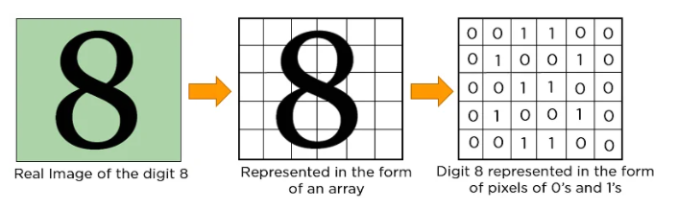
Cont..
In CNN, every image is represented in the form of an array of pixel values.
The Convolution operation forms the basis of any convolutional neural network

Slide 7
Major operations in CNN image Detection/Classification
Convolution
Activation Map
Max pooling
Flattening
Fully connected layer

Slide 8
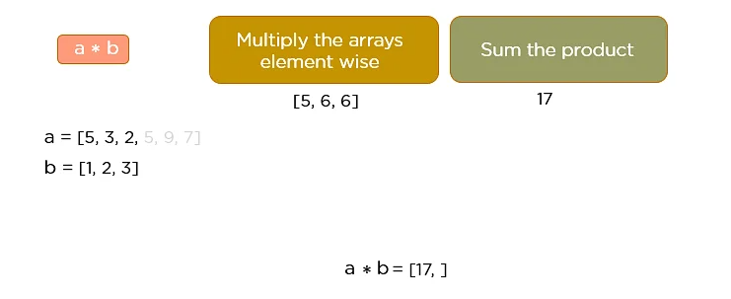
How Convolutional Neural Networks learn?
Images are made up of pixels. Each pixel is represented by a number between 0 and 255. Therefore each image has a digital representation which is how computers can work with images.
Let’s understand the convolution operation using two matrices, a and b, of 1 dimension ,as a = [5,3,2,5,9,7] b = [1,2,3]
In convolution operation, the arrays are multiplied element-wise, and the product is summed to create a new array, which represents a*b.
The first three elements of the matrix a are multiplied with the elements of matrix b. The product is summed to get the result.

Slide 9
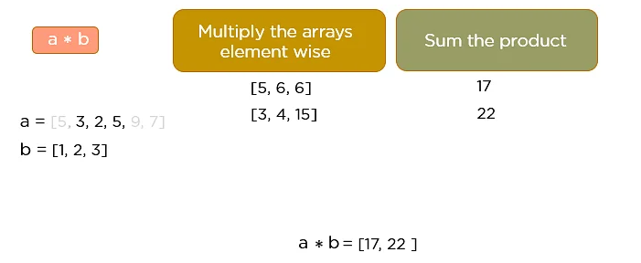
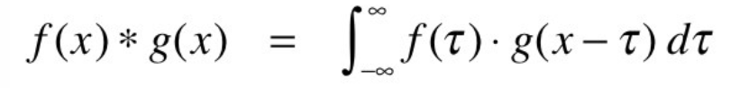
Cont…
The next three elements from the matrix a are multiplied by the elements in matrix b, and the product is summed up.
This process continues until the convolution operation is complete.
Convolution operation works on 2 signals in 1D and 2 images in 2D. Mathematically a convolution is a combined integration of two functions that shows you how one function modifies the other.
Notes:
The main purpose of a convolutional layer is to detect features or visual features in images such as edges, lines, color drops, etc. This is a very interesting property because, once it has learned a characteristic at a specific point in the image, it can recognize it later in any part of it.

Slide 10
Cont….
CNN’s make use of filters (also known as kernels, feature detectors), to detect features, such as edges, are present throughout an image. A filter is just a matrix of values, called weights, that are trained to detect specific features.
The filter moves over each part of the image to check if the feature it is meant to detect is present. To provide a value representing how confident it is that a specific feature is present, the filter carries out a convolution operation, which is an element-wise product and sum between two matrices.
When the feature is present in part of an image, the convolution operation between the filter and that part of the image results in a real number with a high value. If the feature is not present, the resulting value is low.
So we need N number of feature detectors to detect different curves/edges of the image

Slide 11
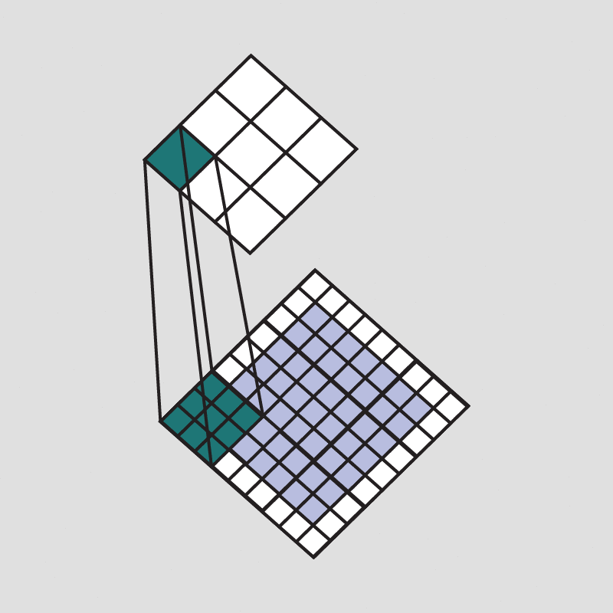
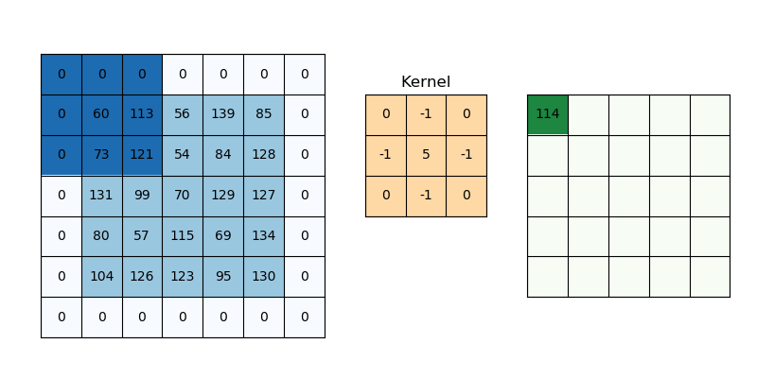
Cont…
Notes:
The result of passing this filter over the entire image is an output matrix called feature maps or convolved features that stores the convolutions of this filter over various parts of the imageThe filter must have the same number of channels as the input image so that the element-wise multiplication can take place.
Additionally, a filter can be slid over the input image at varying intervals, using a stride value. The stride value dictates by how much the filter should move at each step.

Slide 12
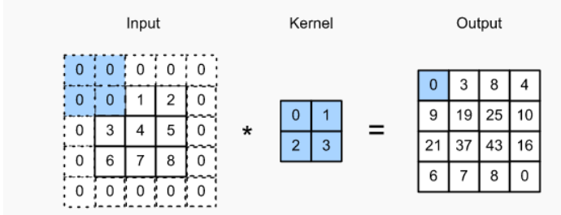
Cont..
Padding :Padding refers to the number of pixels added to an image when it is being processed by the kernel of a CNN.
One solution to assist the kernel with processing the image, pad the image with zeros(zero-padding) to allow for more space for the kernel to cover the image. Adding padding to an image processed by a CNN allows for a more accurate analysis of images.
Notes:
Since we typically use small kernels, for any given convolution, we might only lose a few pixels, but this can add up as we apply many successive convolutional layers.

Slide 13
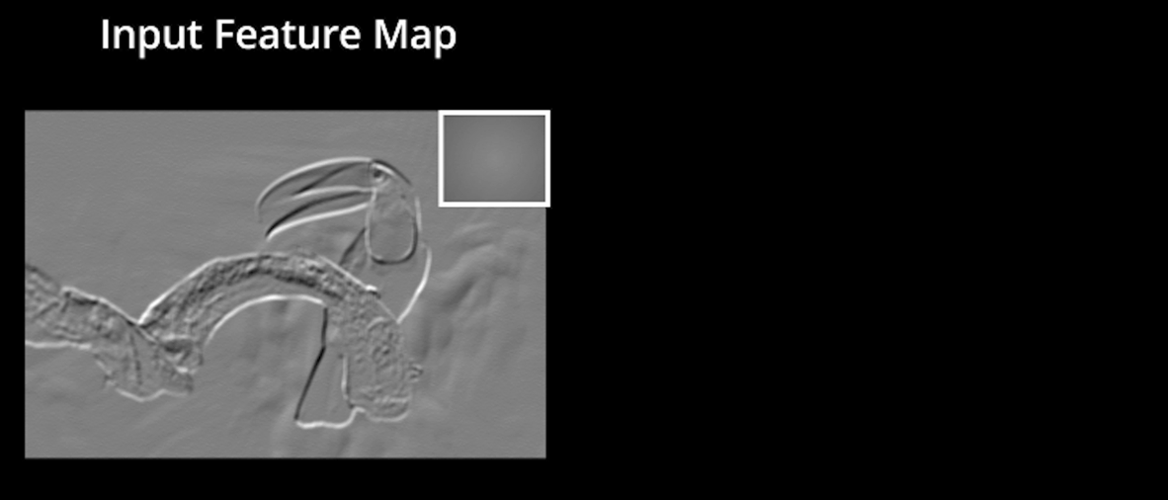
Cont..
Activation Map / ReLU layer :The feature maps are summed with a bias term and passed through a non-linear activation function: ReLu. The purpose of the activation function is to introduce non-linearity into our network because the images are made of different objects that are not linear to each other so the images are highly non-linear.
ReLU performs an element-wise operation and sets all the negative pixels to 0. It introduces non-linearity to the network, and the generated output is a rectified feature map.
The original image is scanned with multiple convolutions and ReLU layers for locating the features.

Slide 14
Cont..
Pooling Layer / Max Pooling :It is a down-sampling operation that reduces the dimensionality of the feature map. The rectified feature map now goes through a pooling layer to generate a pooled feature map.
This helps reduce overfitting, which would occur if CNN is given too much information, especially if that information is not relevant in classifying the image.
There are different types of pooling, for example, max pooling and min pooling. In max pooling, a window passes over an image according to a set stride value. At each step, the maximum value within the window is pooled into an output matrix, hence the name max pooling.
These values then form a new matrix called a Pooled feature map.
An added benefit of max-pooling is that it forces the network to focus on a few neurons instead of all of them which has a regularizing effect on the network, making it less likely to overfit the training data and hopefully generalize well.

Slide 15

Cont..

Slide 16
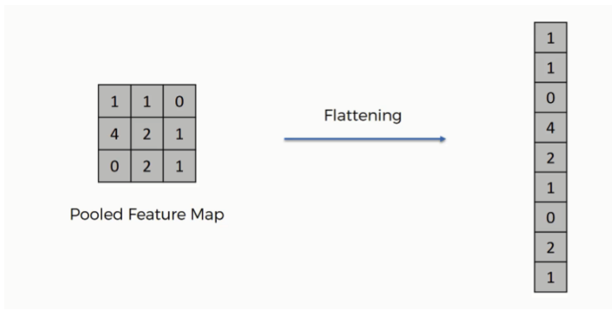
Cont..
After multiple convolution layers and down sampling operations, the 3D representation of the image is converted into a feature vector that is passed into a multi-layer perceptron to output probabilities
Flattening : Flattening is used to convert all the resultant 2-Dimensional arrays from pooled feature maps into a single long continuous linear vector.
The flattened matrix is fed as input to the fully connected layer to classify the image.

Slide 17
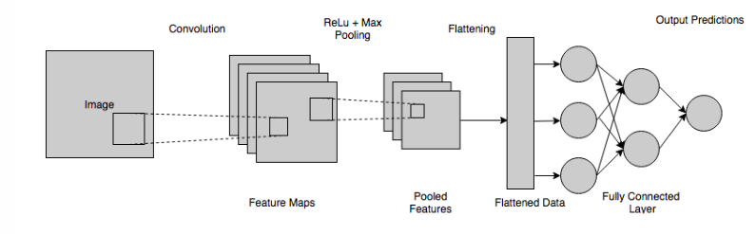
Cont..
Fully Connected Layer : In this step, the flattened feature map is passed through a neural network. This step is made up of the input layer, the fully connected layer, and the output layer.
The fully connected layer is similar to the hidden layer in ANNs but in this case, it’s fully connected. The output layer is where we get the predicted classes. The information is passed through the network and the error of prediction is calculated. The error is then backpropagated through the system to improve the prediction.

Slide 18
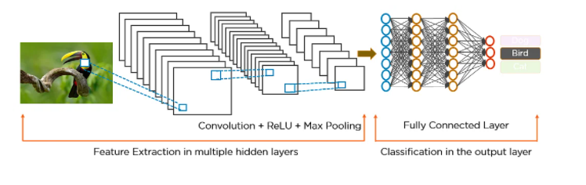
Cont..
The final output produced by the dense layer neural network doesn’t usually add up to one. However, these outputs must be brought down to numbers between zero and one, which represent the probability of each class. This is the role of the Softmax function.
The output of this dense layer is therefore passed through the Softmax activation function, which maps all the final dense layer outputs to a vector whose elements sum up to one.

Slide 19
Summary..
The pixels from the image are fed to the convolutional layer that performs the convolution operation
It results in a convolved map
The convolved map is applied to a ReLU function to generate a rectified feature map
The image is processed with multiple convolutions and ReLU layers for locating the features
Different pooling layers with various filters are used to identify specific parts of the image
The pooled feature map is flattened and fed to a fully connected layer to get the final output

